Slide 1
Optimizing Professional Development for 532d training squadron (TRS)
R. Patrick Anderson
William Dean
R.C. Marshall
Daniel Cook
William Wood

Slide 2
OVERVIEW
Abstract
Background
Problem Statement
Literature Review
Methodology
Results & Analysis
Limitations

Slide 3
Abstract
This study explores the issue of tracking and allocating professional development opportunities for personnel in the 532d TRS at Vandenberg AFB, CA with the overall goal of optimizing the course selection process while ensuring that all instructors receive an opportunity to attend a professional development trip. An optimal solution was discovered that achieves this goal within the constraints of the unit.

Slide 4
Background
The 532d TRS is the entry point into the Nuclear and Missile Operations (Missileer) career field in the Air Force
The unit has 37 instructors and produces 120 new Missileers annually
Professional development of instructors is another responsibility of the unit.
Receives an annual budget of ~$180K to do this
Number and cost of trips varies

Slide 5
Problem Statement
There is no set process in place that optimizes funding, personnel, and events in relation to professional development

Slide 6
Problem Statement-So What?
Lack of optimization leads to many resource management issues, the most prominent being:
Wasted Money
Unused funds are taken away from unit at end of FY
Overspending takes money from other units
Over/Under-allocation
Personnel receiving more opportunities than others
Haves vs Have-Nots
Wasted effort
Sending people on the same trip more than once (Also waste of money)

Slide 7
Literature Review 1
COMPSTAT: Its Origins, Evolution, and Future in Law Enforcement, Bureau of Justice Assistance Police Executive Research Forum, Washington D.C., 2013 <https://www.bja.gov/Publications/PERF-Compstat.pdf>
This report discusses Compstat, a optimization tool that major Police Departments across the country
Developed in 1993 by the NYPD, Compstat determines areas that require more police presence and patrols based on reported crimes
Enabled an optimized allocation of police personnel and resources
Provided tangible reductions in crime and improved operational efficiencies in the NYPD
How does this apply to our project?
The project is a similar endeavor in resource allocation. The only difference are the variables and constraints.

Slide 8
Literature Review 2
A Goal Programming Approach to Rubber Plantation Planning in Tripura, Department of Mathematics Assam University, Silchar, India, 2012 http://www.m-hikari.com/ams/ams-2012/ams-121-124-2012/nandiAMS121-124-2012.pdf
The GP technique was first used by Charnes and Cooper in 1960s
The Rubber Plantation example shows how the owner of the process will give the priority to the goals that are set in the project
How does this apply to our project?
We are using weighted constraints that determine who is going on professional development trips based on multiple goals
We are using data from the previous year and making a fairly significant assumption that the budget will be similar in future years

Slide 9
Methodology
Use Goal programming to balance several goals
Goal 1: Fully utilize funds
Goal 2: Prioritize active instructors
Goal 3: Equitable opportunities
Goal 4: Reward top performers
Decision Variables
1. DV[i,j], where DV is a binary value of (0 or 1) for the ith trip and the jth instructor. A value of 1 indicates that the jth instructor is assigned to the ith trip.

Slide 10

Methodology
Goal Constraints
(Goal 1: Budget) $\left(\sum_{\begin{aligned}1=i=t \\ 1=j=n\end{aligned}}{CostPerPerson\left(i\right)∗DV\left[i,j\right]}\right)−BDminus+BDPostive=ProDTripBudgetTarget$
(Goal 2: Prioritization) $\left(\sum_{\begin{aligned}1=i=t \\ 1=j=n\end{aligned}}{InstructorStatus\left(j\right)∗DV\left[i,j\right]}\right)−IDminus+IDPostive=NumOfProDTripsForActiveInstructorsTarget$
(Goal 3: Equitable) ($\sum_{i=1}^{t}{DV[i,j]}$) – TDpostive [j] $≤$ MaxNumOfTrips, for all j, j=1:n
(Goal 4: Equitable) ($\sum_{i=1}^{t}{DV[i,j]}$) – TDminus [j] $≥$ MinNumOfTrips, for all j, j=1:n
(Goal 5: Reward) $\left(\sum_{\begin{aligned}1=i=t \\ 1=j=n\end{aligned}}{InstructorMerit\left(j\right)∗TripMeritStatus\left[i\right]∗DV[i,j]}\right)−MDminus+MDPostive=TargetNumOfInstructorsToSend…$

Slide 11

Methodology
Hard Constraints
(1. Hard Budget) $\left(\sum_{\begin{aligned}1=i=t \\ 1=j=n\end{aligned}}{CostPerPerson\left(i\right)DV\left[i,j\right]}\right)≤FundsLeft$
(2. Open spots) ($\sum_{j=1}^{n}{DV[i,j]}$) $≤$ InstrSlotsAvailable[i], for all i, i=1:t
Objective Function: Minimize the weighted sum of deviations
$$Min: \sum_{i}{(w_{g}^{−}d_{i}^{−}+w_{g}^{+}d_{i}^{+})}$$

Slide 12
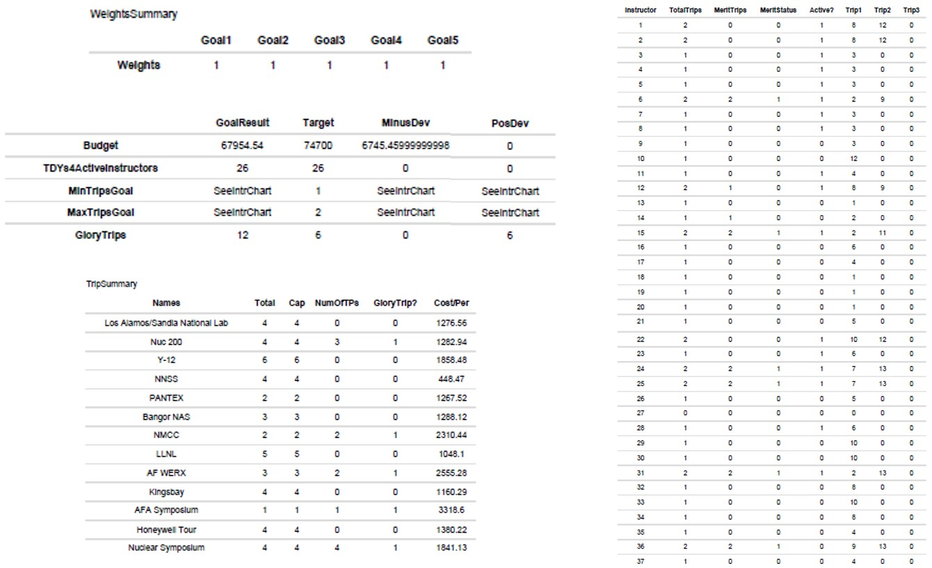
Results & Analysis
An Optimal solution to the problem within the stated methodology was discovered:

Slide 13
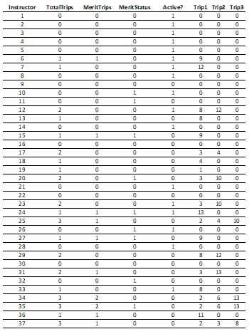
Results & Analysis
The actual results from 2018 were far less than optimal:

Slide 14
Limitations
Personnel, Courses, and the Budget all fluctuate
There may not always be a 1:1 Instructor to course situation
Personnel availability cannot be accurately tracked/measured
Sick Time, Vacation, Unavailability, etc
Budget varies from year to year
Focused on providing professional development opportunities, not measuring effectiveness
Did not measure if professional development offerings improve the ability of the instructors
Doing so would be incredibly difficult and complex

Slide 15
Questions?

